Slide 1
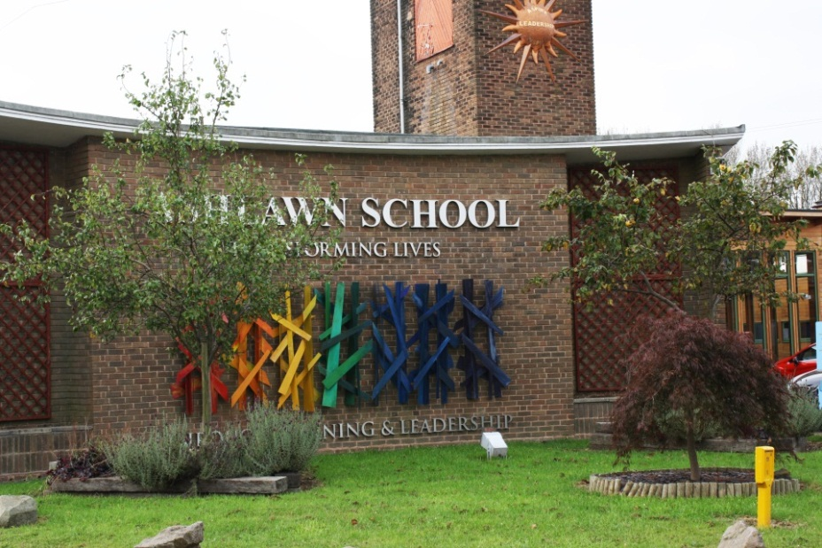
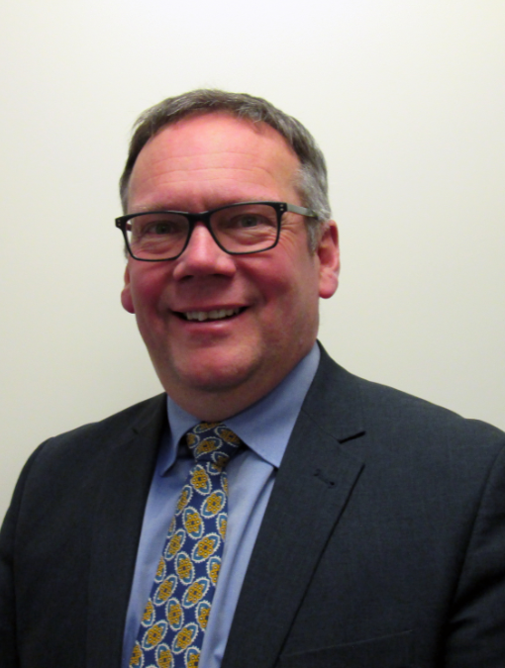
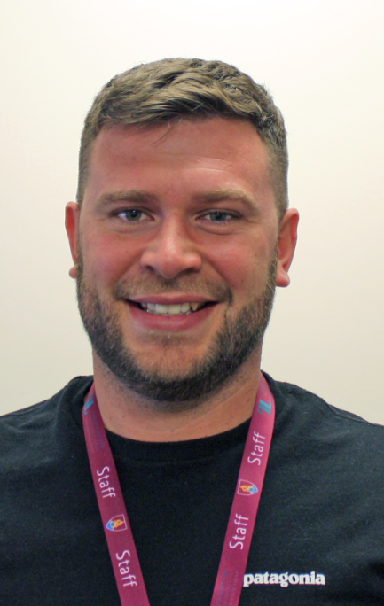
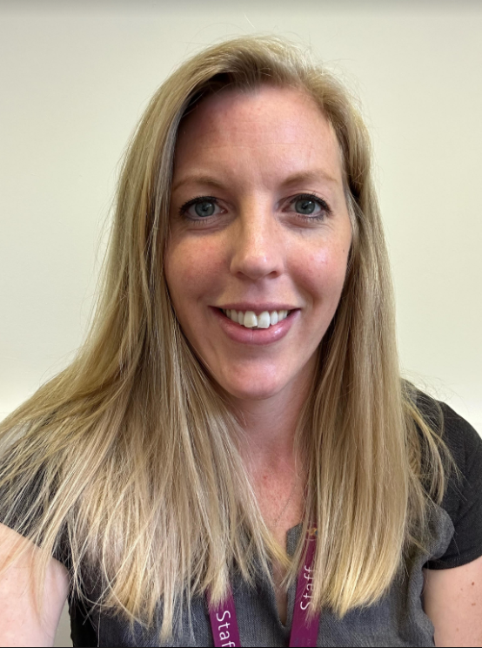
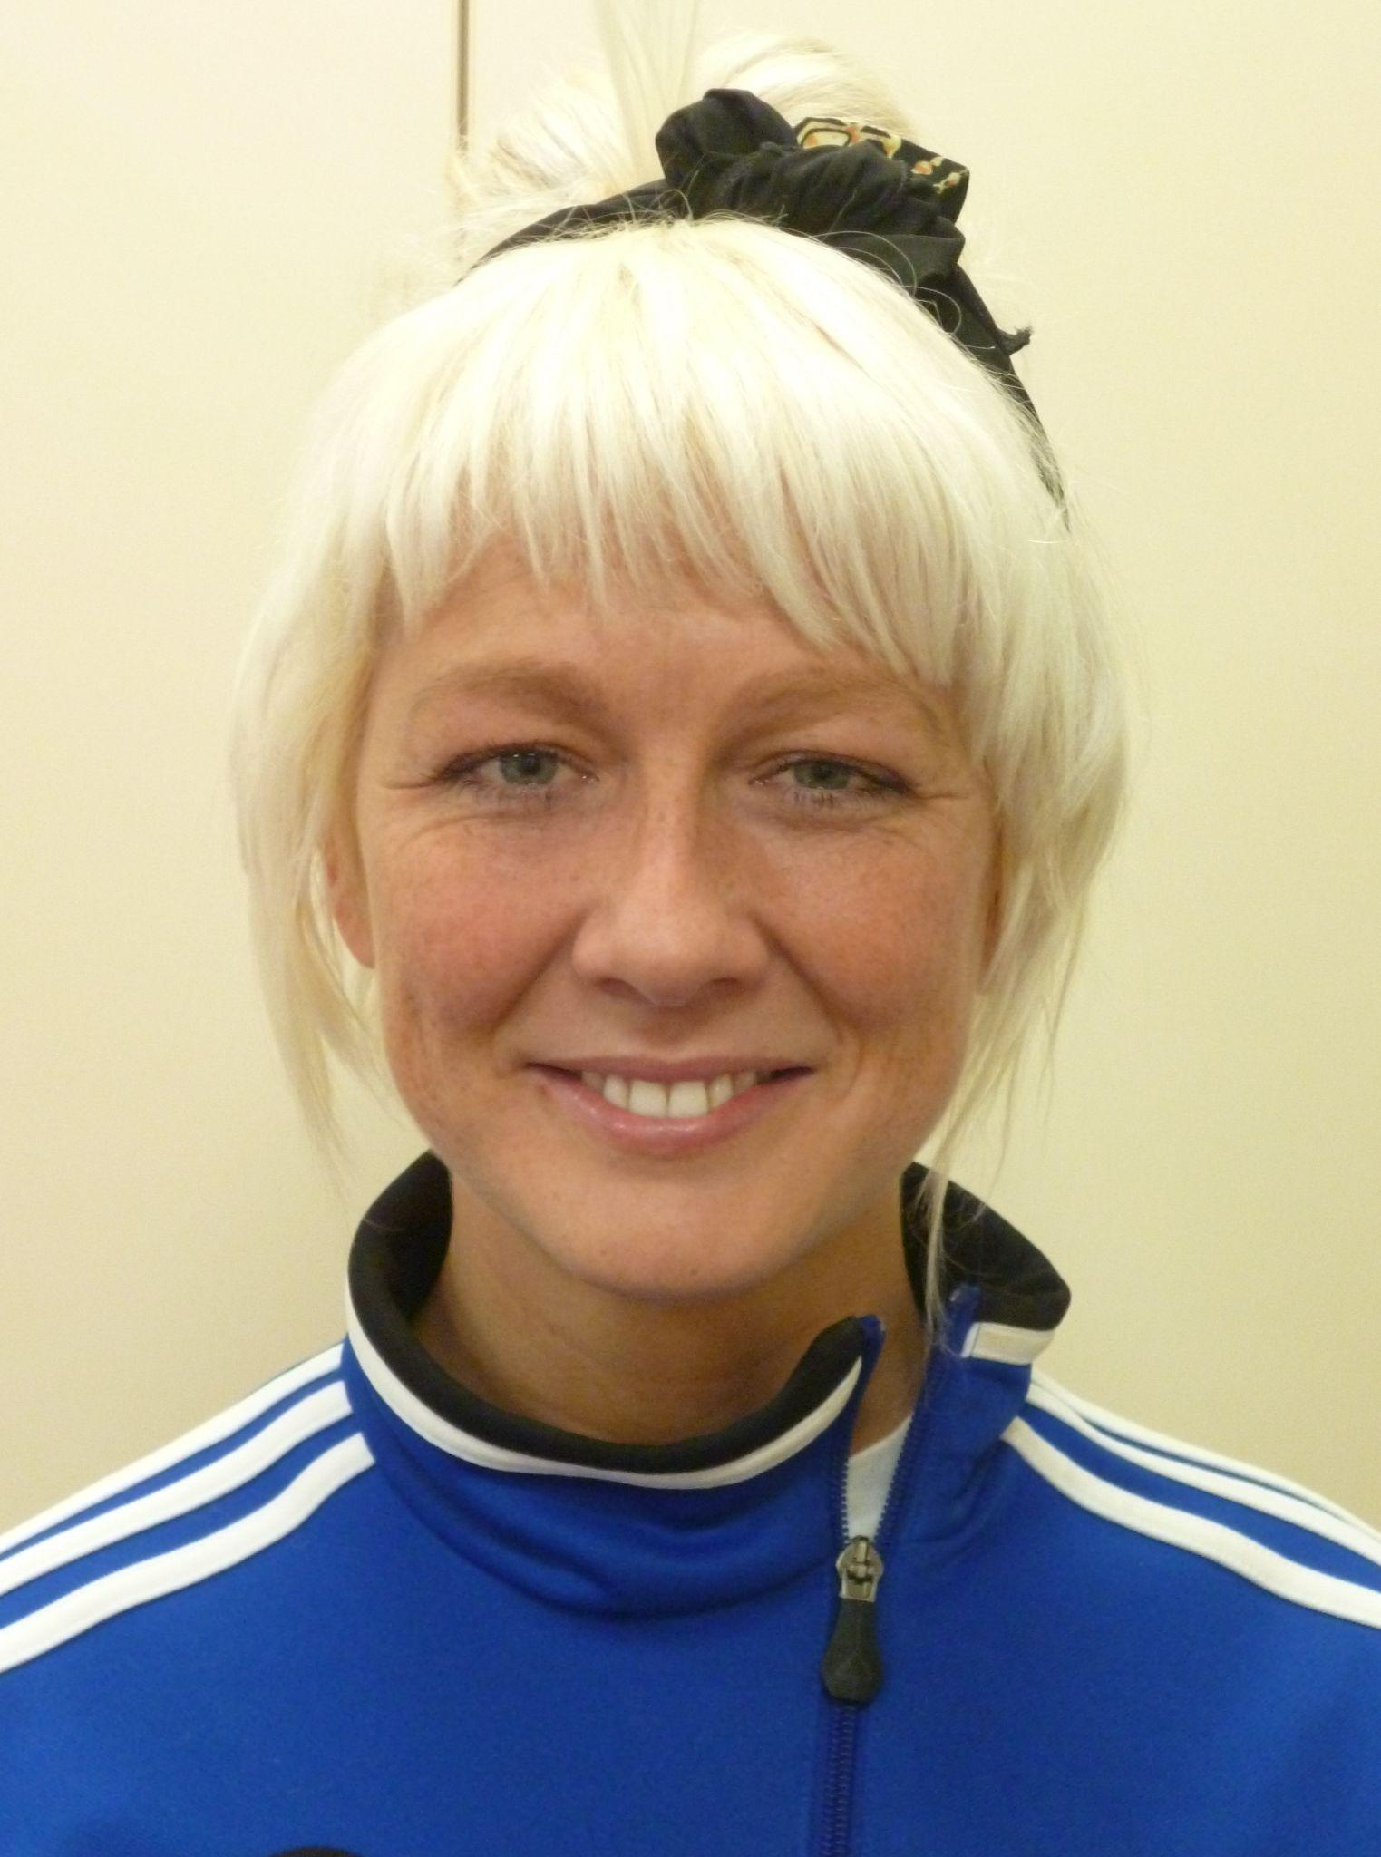
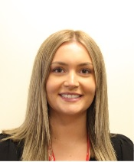
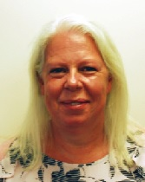
YEAR 6 WELCOME PRESENTATION
Paul Brockwell
Principal
Charlie Pyle
Key Stage 3 Leader
Fern Linnell
Head of Year 7
Becki Brown
Head of Year 7
Lauren Hall
Welfare Lead
Kay Lodge
Pupil Premium

Slide 2
Year 7 Form Tutors
Tutor Group | Form Tutor(s)
7A | A Sanchez sancheza@ashlawn.org.uk
7B | L Morton
7C | J Woolley woolleyj@ashlawn.org.uk
7D | A Dubois duboisa@ashlawn.org.uk
7E | S Goodland and A Williams goodlands@ashlawn.org.uk williamsa@ashlawn.org.uk
7F | T Summers summerst@ashlawn.org.uk
7G | R Goddard and J Moore goddardr@ashlawn.org.uk moorej@ashlawn.org.uk
7H | K Wells wellsk@ashlawn.org.uk
7I | S Massey masseys@ashlawn.org.uk
Form tutors will make contact with you via email, within the first two weeks of term, in order to introduce themselves.

Slide 3
Pastoral Care
Ashlawn School has a dedicated pastoral team who offer care, guidance, support and swift intervention for all students.
We want all of our students to feel safe, happy and confident.
The Head of Year and Welfare lead have oversight for their year group on a day-to-day basis.
Form Tutors meet their tutor group every morning and they are the first and key provider of student support.
Students are also given additional support, as required, by our Learning Development Department, SENco and Welfare Leads.
You are part of the team too please inform the school of any concerns or obstacles to learning. This way we can, as a team, give our students every opportunity to fulfill their academic potential and become purposeful and productive citizens in our wider community.

Slide 4
Contacting School - Desired and Correct Approach
We would always encourage you to get in touch with us if you ever have any questions, concerns or worries. Likewise, we love receiving positive and / or constructive feedback from our parents too!
Guidance for Making Contact
Contact Form Tutors, via email or Edulink, in the first instance. If we can’t answer your query we will triage it to the right colleagues who will get back to you as soon as possible.
For any emergencies please call main reception.
If you have a safeguarding concern call reception and ask to speak to a Designated Safeguarding Lead or send an email to safeguarding@ashlawn.org.uk
Please do not arrive at reception to see a member of staff without having called ahead to make an appointment. Our pastoral staff teach and attend various meetings. They may not be available to see you.

Slide 5
Uniform
Core Uniform:
● Ashlawn School logo polo shirt (Burgundy for Y7-9 and Black for Y10-11)
● Black, smart, tailored trousers (please note that trousers should be full length, in a fabric suitable for formal wear and with a button and a zip. Trousers that have rivets or stitching like jeans are not permitted. Leggings are not permitted)
● Ashlawn School logo knitted jumper/cardigan (if student wishes to wear a jumper)
● Plain black leather or leather look shoes or trainers
● Coats and outer garments should be black, dark grey or navy blue
Optional Uniform Items:
● Ashlawn School logo pleated skirt.
● Ashlawn School logo shorts Please note students can only wear a pleated Ashlawn skirt with logo or shorts with a logo. No other skirts or shorts will be permitted.
Jewellery:
● Students may wear one pair of stud earrings
● Students may wear a watch
● Rings, bracelets and necklaces are not permitted however negotiation will be considered for religious purposes
● Nose studs and facial piercings are not permitted Students wearing excessive jewellery will be asked to remove the jewellery, place it in an envelope and collect it at the end of the school day.

Slide 6
Uniform
We believe that a school uniform is part of a school’s culture and it gives our students a sense of belonging to our school. It also prepares students for the expectations around standards of dress in the wider world of work.
How can parents / carers help?
Get uniform ahead of time - Webb Ellis / Scallywagz / PTA
Ensure that uniform is clean and easily available for students - make them part of the routine!
Check your child’s appearance / standard of dress before they leave for school.
Don’t allow piercings, which are not in line with the school’s uniform policy, to be had until the very start of the summer holiday
Support the school’s position regarding the importance of meeting expectations regarding standard of dress and appearance.
Most common issues:
Incorrect footwear
False nails
Rolled up skirts
Inappropriate piercings
Leggings
Incorrect coat colours

Slide 7
UNIFORM - SUPPLIERS
All uniform must carry the Ashlawn logo/monogram and is available from the following suppliers:-
Webb Ellis Ltd, 5 & 6 St. Matthew's Street, Rugby, CV21 3BY. Telephone: 01788 567777.
Scallywagz, 82 High Street, Daventry, NN11 4HU. Telephone: 01327 700069.
PTA Second Hand Uniform Shop - Usually the last Saturday of each month, please see our school calendar on our website (www.ashlawn.org.uk/calendar) for dates.

Slide 8
Timetable and Preparation
How can parents / carers help?
Ensure your child has their laminated timetable / printed copy of their timetable each evening. Their individual timetables will also be stuck into their planner.
You can check your child’s timetable on edulink.
Help establish a bag packing routine each evening - check that books packed match the lessons for the next day, ensure that your child is equipped to learn.
Contact Form Tutors if at any stage your child loses their timetable.
Ensure your child has their PE kit on PE days!

Slide 9
Being Prepared - Equipment
How can parents / carers help?
Ensure that your child has the following items:
A two strapped durable backpack suitable for carrying A4 sized books.
A pencil case
Pens - black and green (for responding to feedback)
Pencils
A sharpener
A rubber
Highlighters
Ruler
Whiteboard pen
Age appropriate reading book
A watch
A calculator
A protractor
A compass

Slide 10
Edulink
A particularly important application that can be accessed online using a web browser or by downloading it on a smartphone or other smart device.
All parents should download and then access Edulink regularly. We recommend using the school’s guide to help you get oriented with Edulik. Edulink will be available from September for you to use.
Edulink User Guide
How can parents / carers help by using Edulink?
Check your child’s timetable and help them get organised.
Check homework that has been set and completed by your child.
Review achievement points, behaviour points, attendance data and school reports.
Communicate with teaching staff.
Report absences and update details.

Slide 11
Attendance and Punctuality
There is a strong correlation between attendance and attainment. As such, having excellent attendance puts students in a better position to fulfil their potential.
90% = ½ day a week = 4 weeks a year missing from education
Over 5 years this is the equivalent of ½ a school year missing from education
80% = 1 day a week.
Over 5 years this is the equivalent of 1 school year missing from education
We aim to achieve 100% attendance wherever possible.
School gates are open from 8.30am-8.45am and if students arrive after this time they will be marked late. Punctuality is important as it reflects the reality of working life and the expectations that employers will have.
How can parents / carers help?
Genuine illness cannot be helped but please keep the school informed by reporting illness using edulink or the following phone number: 01788 532831
Support our message that attendance at school is crucial if potential is to be fulfilled.
Sometimes students are ‘ill’ when there are other reasons for not wanting to go to school - as parents you will likely get a feeling for when this might be the case.
Communicate with us if you have any concerns about school avoidance.

Slide 12
Home Learning Activities
All homework will be set on Edulink which is an app that can be downloaded by parents/carers in order to receive notifications regarding the work being set.
New Home Learning Policy for 2023
How can parents / carers help?
Check Edulink regularly to see what homework has been set.
Support students with home learning activities.
Use home learning as an opportunity to discuss wider learning and explore other interests and issues raised. .
Contact subject teachers using Edulink if you have any queries or concerns regarding home learning activities.

Slide 13
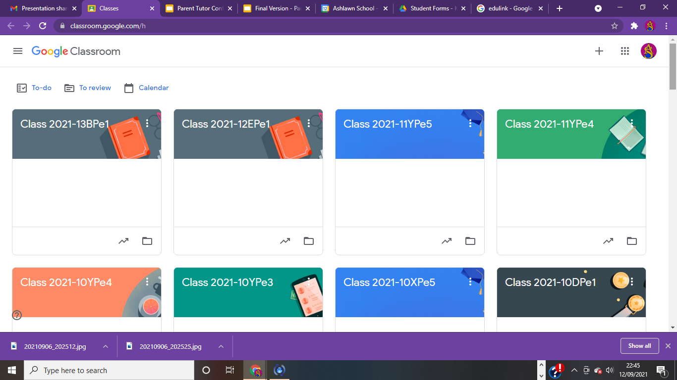
Google Classroom
Each teacher will have a Google Classroom set up for all of their classes. Students are automatically added to classrooms but if an additional classroom is created they will be given a code to join.
Google classroom is used to post homework tasks as well as for sharing key learning resources.
Students can access the classroom to see their homework tasks and they can also send messages to subject teachers using this platform.

Slide 14
Parent Pay and Food at School
Ashlawn is a cashless school and we accept payments online for items such a dinner money, school trips and School Fund donations using a secure website called Parent Pay.
How can parents / carers help?
Complete the Ashlawn School registration form to gain access to Parent Pay.
Students can purchase food using their fingerprint or pin linked to the Parent Pay account
Top balances up if you would like your child to be able to purchase items before school or during break.
Review your account regularly to review purchases made by your child.
Contact the school if you are having any difficulties with Parent Pay.
You can apply for free school meals using this link: Free School Meals.

Slide 15
Mobile Phones / Emerging Technology
The mobile phone policy has changed. Students can now have their phones in school, the phone however is expected to be off and in their school bag.
If a student needs to phone home they can do this from Student Services or the appropriate Head of Years office.
If a parent needs to contact a student urgently then they should telephone the school and a message will be taken to the student immediately.
Any phone that is seen, or if student(s) are caught using them they will be confiscated and taken to student services. Students will be able to collect their phone at the end of the day, on the first occasion only. After this point, parents will be contacted to collect the phone.
If this should happen to your child you will be telephoned by reception or the Head of Year to arrange a time to collect the phone.

Slide 16
Mobile Phones / Emerging Technology
How can parents / carers help?
Only allow your child to bring a mobile phone to school if you feel it is imperative for their safety during their commute to and from school.
Encourage your child to keep their phone off and in their bag, or hand in their mobile phone when they arrive at the school gate.
Ensure that your child knows the rules regarding using a mobile phone at school and the safeguarding risks that doing so can create.
Support the school should your child’s phone be confiscated and reiterate our expectations regarding mobile phone use on the school premises.

Slide 17
Advice on Safeguarding Your Children
How can parents / carers help?
Debrief your children on their day - check in regularly and meaningfully.
Encourage structured socialising - don’t allow your children to ‘roam’ the neighbourhood.
Ensure you know where your children are and who they are with.
Have oversight of your child’s mobile devices and internet access.
Do not allow your child to join ‘group chats’.
Highlight the dangers of sharing information, photographs and videos online.
Prevent social media use until the required age of 13.
Liaise with the school if you are concerned about your child at any stage.

Slide 18
Supporting the School
How can parents / carers help?
Be a part of school community and work with us in partnership to achieve the very best outcomes possible for your children.
Treat all of our staff with respect.
Speak to us when you have worries, concerns or questions.
Please book appointments to speak to staff and do not turn up without a pre-arranged appointment.
Support our school policies and do not undermine them. They are there to safeguard students, push them to fulfil their potential and prepare them for life beyond school.

Slide 19
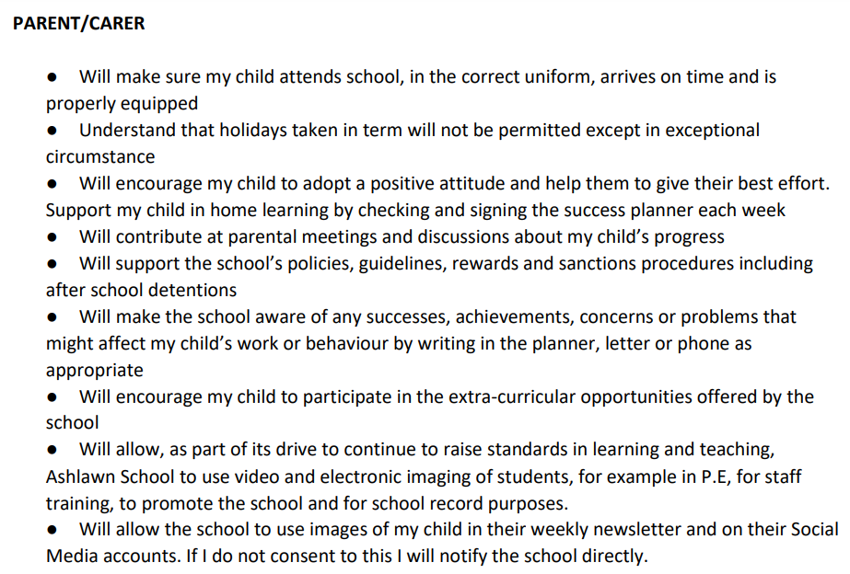
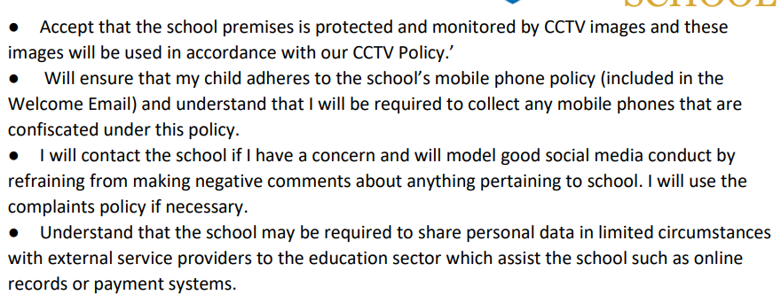
Home School Agreement

Slide 20
Summer School
Tuesday 22nd August and Wednesday 23rd August
10:00 - 14:00

Slide 21
CONTACT
Key Contacts for September
Mr Pyle (Key Stage 3 Leader)
pylec@ashlawn.org.uk
Mrs Linnell (Head of Year 7)
linnellf@ashlawn.org.uk
Mrs Brown (Head of Year 7)
brownr@ashlawn.org.uk
If you have a safeguarding concern you can reach our safeguarding team using the email below.
safeguarding@ashlawn.org.uk
You can contact the school directly on 01788 573425.
The school may contact you via text message using the following numbers so please have these saved in your phone.
Ashlawn Attendance: 07624 816522
Ashlawn General Administration: 07624 816513

Slide 22
Ashlawn School - Social Media
Facebook - Ashlawn School
Instagram - ashlawnschool_rugby
Twitter - @AshlawnSchool

